Slide 1
Transaction and Concurrency Control
UNIT-V

Slide 2
TOPICS TO BE COVERED
Single user and Multiuser system
Multiprogramming and multiprocessing
Database access operations’
Concept of transaction
Transaction state
ACID properties
Schedules
Serializability of schedule
Concurrency control
Need for concurrency’

Slide 3
Topic to be covered
Lock based protocols
Multiple granularity
Multiple version techniques
Wait-die and wait-wound
Deadlock prevention without using time stamps
Dead lock detection and time outs
starvation

Slide 4
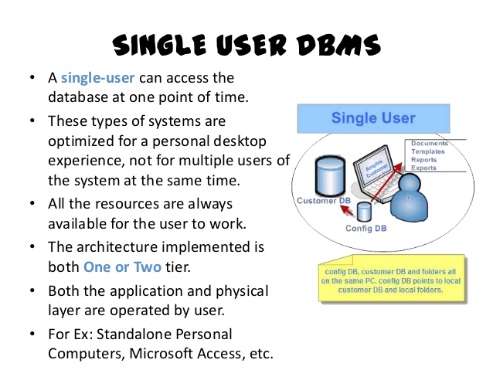

Slide 5
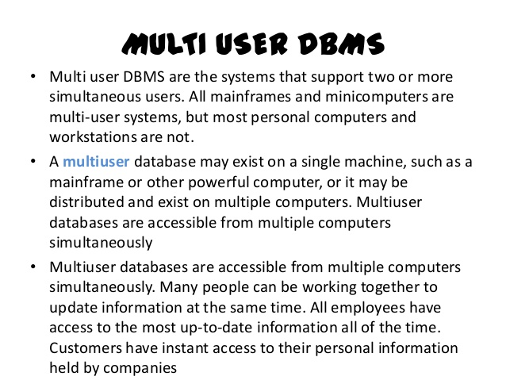

Slide 6
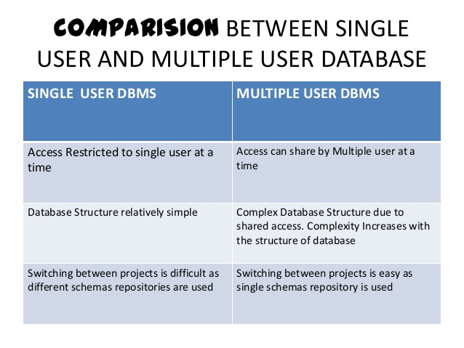

Slide 7
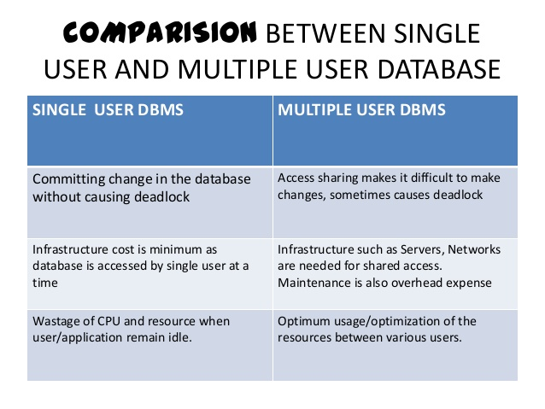

Slide 8
Multiprogramming
Multiprogramming is also the ability of an operating system to execute more than one program on a single processor machine.
More than one task/program/job/process can reside into the main memory at one point of time.
A computer running excel and Firefox browser simultaneously is an example of multiprogramming.

Slide 9
The main idea of multiprogramming is to maximize the use of CPU time. Indeed, suppose the currently running process is performing an I/O task (which, by definition, does not need the CPU to be accomplished). Then, the OS may interrupt that process and give the control to one of the other in-main-memory programs that are ready to execute (i.e. process context switching).
Note that in order for such a system to function properly, the OS must be able to load multiple programs into separate areas of the main memory and provide the required protection to avoid the chance of one process being modified by another one. Other problems that need to be addressed when having multiple programs in memory is fragmentation as programs enter or leave the main memory.

Slide 10
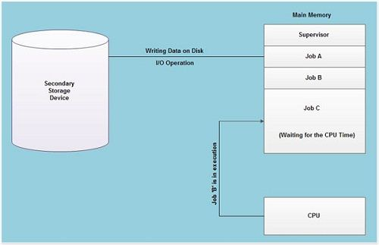
Multi programming
As shown in fig, at the particular situation, job' A' is not utilizing the CPU time because it is busy in I/ 0 operations. Hence the CPU becomes busy to execute the job 'B'. Another job C is waiting for the CPU for getting its execution time. So in this state the CPU will never be idle and utilizes maximum of its time.

Slide 11
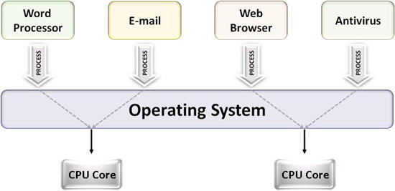
Multiprocessing
Multiprocessing is the ability of an operating system to execute more than one process simultaneously on a multi processor machine.
In this, a computer uses more than one CPU at a time.

Slide 12
Multi processing system’s working –
With the help of multiprocessing, many processes can be executed simultaneously. Say processes P1, P2, P3 and P4 are waiting for execution. Now in a single processor system, firstly one process will execute, then the other, then the other and so on.
But with multiprocessing, each process can be assigned to a different processor for its execution. If its a dual-core processor (2 processors), two processes can be executed simultaneously and thus will be two times faster, similarly a quad core processor will be four times as fast as a single processor.

Slide 13
Basic database access operations
Operation | SQL | HTTP | DDS
Create | INSERT | PUT / POST | write
Read (Retrieve) | SELECT | GET | read / take
Update (Modify) | UPDATE | PUT / PATCH | write
Delete (Destroy) | DELETE | DELETE | dispose

Slide 14
What is a Transaction?
A transaction is an action, or series of actions that are being performed by a single user or application program, which reads or updates the contents of the database.
Any action that reads from and/or writes to a database may consist of
  Simple SELECT statement to generate a list of table contents
  A series of related UPDATE statements to change the values of attributes in various tables
  A series of INSERT statements to add rows to one or more tables
  A combination of SELECT, UPDATE, and INSERT statements

Slide 15
What is a Transaction cont..
A logical unit of work that must be either entirely completed or aborted
Successful transaction changes the database from one consistent state to another
  One in which all data integrity constraints are satisfied
Most real-world database transactions are formed by two or more database requests
  The equivalent of a single SQL statement in an application program or transaction

Slide 16
Evaluating Transaction Results
Not all transactions update the database
SQL code represents a transaction because database was accessed
Improper or incomplete transactions can have a devastating effect on database integrity
  Some DBMSs provide means by which user can define enforceable constraints based on business rules
  Other integrity rules are enforced automatically by the DBMS when table structures are properly defined, thereby letting the DBMS validate some transactions

Slide 17
Transaction Processing
For example, a transaction may involve
  The creation of a new invoice
  Insertion of an row in the LINE table
  Decreasing the quantity on hand by 1
  Updating the customer balance
  Creating a new account transaction row
If the system fails between the first and last step, the database will no longer be in a consistent state
Figure 9.2

Slide 18
Transaction Properties
Atomicity
  Requires that all operations (SQL requests) of a transaction be completed; if not, then the transaction is aborted
  A transaction is treated as a single, indivisible, logical unit of work
Consistency − The database must remain in a consistent state after any transaction. No transaction should have any adverse effect on the data residing in the database. If the database was in a consistent state before the execution of a transaction, it must remain consistent after the execution of the transaction as well.

Slide 19
Transaction Properties
Isolation
  Data used during execution of a transaction cannot be used by second transaction until first one is completed
Durability
  Indicates permanence of database’s consistent state
  When a transaction is complete, the database reaches a consistent state. That state can not be lost even if the system fails

Slide 20
Transaction Management with SQL
ANSI has defined standards that govern SQL database transactions
Transaction support is provided by two SQL statements: COMMIT and ROLLBACK
ANSI standards require that, when a transaction sequence is initiated by a user or an application program, it must continue through all succeeding SQL statements until one of four events occurs

Slide 21
Transaction Management with SQL
A COMMIT statement is reached- all changes are permanently recorded within the database
A ROLLBACK is reached – all changes are aborted and the database is restored to a previous consistent state
The end of the program is successfully reached – equivalent to a COMMIT
The program abnormally terminates and a rollback occurs

Slide 22
Active State | A transaction enters into an active state when the execution process begins. During this state read or write operations can be performed.
Partially Committed | A transaction goes into the partially committed state after the end of a transaction.

Slide 23
Committed State | When the transaction is committed to state, it has already completed its execution successfully. Moreover, all of its changes are recorded to the database permanently.
Failed State | A transaction considers failed when any one of the checks fails or if the transaction is aborted while it is in the active state.
Terminated State | State of transaction reaches terminated state when certain transactions which are leaving the system can't be restarted.

Slide 24
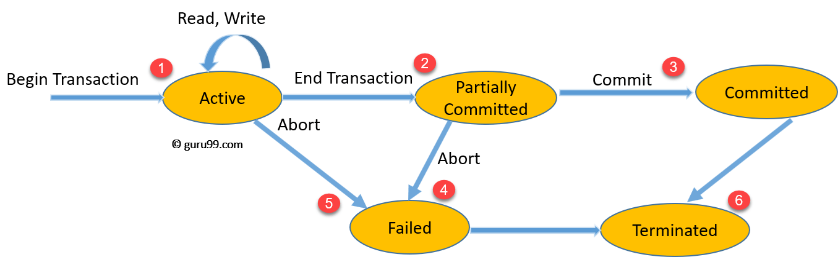
Transaction Execution / and Its state

Slide 25
Once a transaction states execution, it becomes active. It can issue READ or WRITE operation.
Once the READ and WRITE operations complete, the transactions becomes partially committed state.
Next, some recovery protocols need to ensure that a system failure will not result in an inability to record changes in the transaction permanently. If this check is a success, the transaction commits and enters into the committed state.
If the check is a fail, the transaction goes to the Failed state.
If the transaction is aborted while it's in the active state, it goes to the failed state. The transaction should be rolled back to undo the effect of its write operations on the database.
The terminated state refers to the transaction leaving the system.

Slide 26
The Transaction Log
Keeps track of all transactions that update the database. It contains:
  A record for the beginning of transaction
  For each transaction component (SQL statement)
    Type of operation being performed (update, delete, insert)
    Names of objects affected by the transaction (the name of the table)
    “Before” and “after” values for updated fields
    Pointers to previous and next transaction log entries for the same transaction
  The ending (COMMIT) of the transaction
Increases processing overhead but the ability to restore a corrupted database is worth the price

Slide 27
The Transaction Log
  Increases processing overhead but the ability to restore a corrupted database is worth the price
  If a system failure occurs, the DBMS will examine the log for all uncommitted or incomplete transactions and it will restore the database to a previous state
  The log it itself a database and to maintain its integrity many DBMSs will implement it on several different disks to reduce the risk of system failure

Slide 28
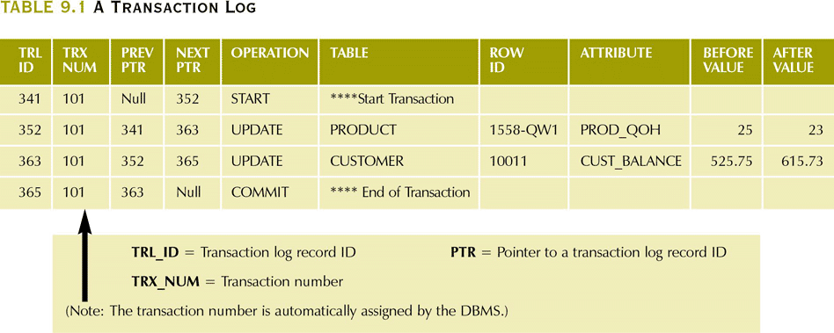
A Transaction Log

Slide 29
Concurrency Control
The coordination of the simultaneous execution of transactions in a multiprocessing database is known as concurrency control
The objective of concurrency control is to ensure the serializability of transactions in a multiuser database environment

Slide 30
Need of Concurrency Control
  Important → simultaneous execution of transactions over a shared database can create several data integrity and consistency problems
  The three main problems are:
    lost updates
    uncommitted data
    inconsistent retrievals

Slide 31
lost update
A lost update occurs when two different transactions are trying to update the same column on the same row within a database at the same time. Typically, one transaction updates a particular column in a particular row, while another that began very shortly afterward did not see this update before updating the same value itself.

Slide 32
Uncommitted Data Problem
Uncommitted data occurs when two transactions execute concurrently and the first is rolled back after the second has already accessed the uncommitted data
  This violates the isolation property of transactions

Slide 33
Inconsistent Retrieval Problem
Occur when a transaction calculates some aggregate functions over a set of data while transactions are updating the data
Some data may be read after they are changed and some before they are changed yielding inconsistent results

Slide 34
Advantage of concurrency control
By having concurrency control we avoid dirty writes (or inconsistent data). It is like your traffic signal - allows one set of users (drivers) to pass through at a time. In computer terms, if a user wants to update some data then the following steps are taken:
(a) the data is fetched along with the timestamp (the date, time when it was last modified)
(b) the data is modified by the user who then submits the data for update / storage in the system

Slide 35
Reduced waiting time. There may be a mix of transactions running on a system, some short and some long. If transactions run serially, a short transaction may have to wait for a preceding long transaction to complete, which can lead to unpredictable delays in running a transaction. If the transactions are operating on different parts of the database, it is better to let them run concurrently, sharing the CPU cycles and disk accesses among them

Slide 36
Improved throughput and resource utilization. A transaction consists of many steps. Some involve I/O activity; others involve CPU activity. The CPU and the disks in a computer system can operate in parallel. Therefore, I/O activity can be done in parallel with processing at the CPU. The parallelism of the CPU and the I/O system can, therefore, be exploited to run multiple transactions in parallel. While a read or write on behalf of one transaction is in progress on one disk, another transaction can be running in the CPU, while another disk may be executing a read or write on behalf of a third transaction.

Slide 37
The Scheduler
Special DBMS program: establishes order of operations within which concurrent transactions are executed
Interleaves the execution of database operations to ensure serializability and isolation of transactions
  To determine the appropriate order, the scheduler bases its actions on concurrency control algorithms such as locking and time stamping

Slide 38
The Scheduler (continued)
Ensures computer’s central processing unit (CPU) is used efficiently
  Default would be FIFO without preemption – idle CPU (during I/O) is inefficient use of the resource and result in unacceptable response times in within the multiuser DBMS environment.
Facilitates data isolation to ensure that two transactions do not update the same data element at the same time

Slide 39
Concurrency Control with Locking Methods
Lock
  Guarantees exclusive use of a data item to a current transaction
    Required to prevent another transaction from reading inconsistent data Ex: T2 does not have access to a data item that is currently being used by T1
    Transaction acquires a lock prior to data access; the lock is released when the transaction is complete
Lock manager
  Responsible for assigning and policing the locks used by the transactions

Slide 40
Lock Granularity
Indicates the level of lock use
Locking can take place at the following levels:
  Database-level lock
    Entire database is locked
  Table-level lock
    Entire table is locked
  Page-level lock
    Entire diskpage is locked
  Row-level lock
    Allows concurrent transactions to access different rows of the same table, even if the rows are located on the same page
  Field-level lock
    Allows concurrent transactions to access the same row, as long as they require the use of different fields (attributes) within that row

Slide 41
Lock Types:
1. Binary Locks
It Has only two states: locked (1) or unlocked (0)
A distinct lock is associated with each database item A. If the value of the lock on A is 1, item A cannot be accessed by a database operation that requests the item. If the value of the lock on A is 0 then item can be accessed when requested.
Eliminates “Lost Update” problem – the lock is not released until the write statement is completed
  Can not use PROD_QOH until it has been properly updated
Considered too restrictive to yield optimal concurrency conditions as it locks even for two READs when no update is being done

Slide 42
Shared/Exclusive Locks
Exclusive lock
  Access is specifically reserved for the transaction that locked the object
  Must be used when the potential for conflict exists – when a transaction wants to update a data item and no locks are currently held on that data item by another transaction
  Granted if and only if no other locks are held on the data item
Shared lock
  Concurrent transactions are granted Read access on the basis of a common lock
  Issued when a transaction wants to read data and no exclusive lock is held on that data item
      Multiple transactions can each have a shared lock on the same data item if they are all just reading it
Mutual Exclusive Rule
  Only one transaction at a time can own an exclusive lock in the same object

Slide 43
Shared/Exclusive Locks
Increased overhead
  The type of lock held must be known before a lock can be granted
  Three lock operations exist:
    READ_LOCK to check the type of lock
    WRITE_LOCK to issue the lock
    UNLOCK to release the lock
  A lock can be upgraded from share to exclusive and downgraded from exclusive to share
Two possible major problems may occur
  The resulting transaction schedule may not be serializable
  The schedule may create deadlocks

Slide 44
Two-Phase Locking to Ensure Serializability
Two-Phase locking protocol which is also known as a 2PL protocol. It is also called P2L. In this type of locking protocol, the transaction should acquire a lock after it releases one of its locks.
This locking protocol divides the execution phase of a transaction into three different parts.
In the first phase, when the transaction begins to execute, it requires permission for the locks it needs.
The second part is where the transaction obtains all the locks. When a transaction releases its first lock, the third phase starts.
In this third phase, the transaction cannot demand any new locks. Instead, it only releases the acquired locks.

Slide 45
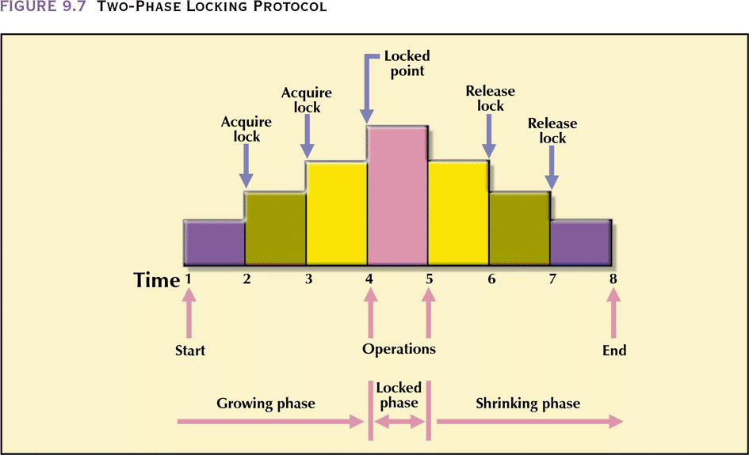
Two-Phase Locking Protocol

Slide 46
Two-Phase Locking contd..
Defines how transactions acquire and relinquish locks
Guarantees serializability, but it does not prevent deadlocks
  Growing phase, in which a transaction acquires all the required locks without unlocking any data
  Shrinking phase, in which a transaction releases all locks and cannot obtain any new lock

Slide 47
Two-Phase Locking to Ensure Serializability
Governed by the following rules:
  Two transactions cannot have conflicting locks
  No unlock operation can precede a lock operation in the same transaction
  No data are affected until all locks are obtained—that is, until the transaction is in its locked point

Slide 48
Deadlocks
Condition that occurs when two transactions wait for each other to unlock data. Deadlock is said to be one of the most feared complications in DBMS as it brings the whole system to a Halt.
T1 needs data items X and Y; T needs Y and X
  Each gets the its first piece of data but then waits to get the second (which the other transaction is already holding) – deadly embrace
Possible only if one of the transactions wants to obtain an exclusive lock on a data item
  No deadlock condition can exist among shared locks
Control through
  Prevention
  Detection
  Avoidance

Slide 49
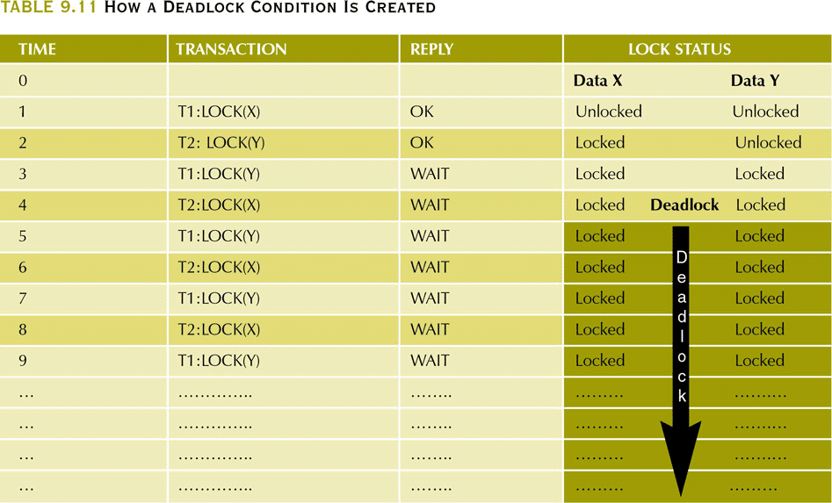
How a Deadlock Condition Is Created

Slide 50
Deadlock Prevention
To prevent any deadlock situation in the system, the DBMS aggressively inspects all the operations, where transactions are about to execute. The DBMS inspects the operations and analyzes if they can create a deadlock situation. If it finds that a deadlock situation might occur, then that transaction is never allowed to be executed.

Slide 51
Wait-Die Scheme – Dead lock prevention scheme
Wait-Die Scheme
In this scheme, if a transaction requests to lock a resource (data item), which is already held with a conflicting lock by another transaction, then one of the two possibilities may occur
If TS(T_{i}) < TS(T_{j}) − that is T_{i}, which is requesting a conflicting lock, is older than T_{j} − then T_{i} is allowed to
wait until the data-item is available.
If TS(T_{i}) > TS(t_{j}) − that is T_{i} is younger than T_{j} − then T_{i} dies. T_{i} is restarted later with a random delay but
with the same timestamp.
This scheme allows the older transaction to wait but kills the younger one.

Slide 52
wound wait scheme
In wound wait scheme, if the older transaction requests for a resource which is held by the younger transaction, then older transaction forces younger one to kill the transaction and release the resource. After the minute delay, the younger transaction is restarted but with the same timestamp.
If the older transaction has held a resource which is requested by the Younger transaction, then the younger transaction is asked to wait until older releases it.

Slide 53
Deadlock Avoidance
Deadlock avoidance mechanism is used to detect any deadlock situation in advance. A method like "wait for graph" is used for detecting the deadlock situation but this method is suitable only for the smaller database. For the larger database, deadlock prevention method can be used.

Slide 54
This is the suitable method for deadlock detection. In this method, a graph is created based on the transaction and their lock. If the created graph has a cycle or closed loop, then there is a deadlock.
The wait for the graph is maintained by the system for every transaction which is waiting for some data held by the others. The system keeps checking the graph if there is any cycle in the graph.

Slide 55
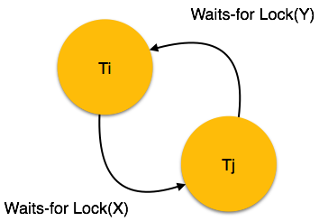

Slide 56
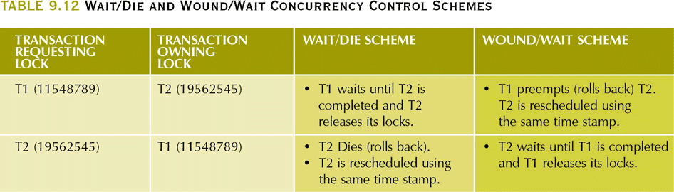
Wait/Die and Wound/Wait
Concurrency Control Schemes

Slide 57
Concurrency Control with Optimistic Methods
Optimistic approach
  Based on the assumption that the majority of database operations do not conflict
  Does not require locking or time stamping techniques
  Transaction is executed without restrictions until it is committed
  Acceptable for mostly read or query database systems that require very few update transactions
  Phases are read, validation, and write

Slide 58
Concurrency Control with Optimistic Methods
Phases are read, validation, and write
  Read phase – transaction reads the database, executes the needed computations and makes the updates to a private copy of the database values.
    All update operations of the transaction are recorded in a temporary update file which is not accessed by the remaining transactions
  Validation phase – transaction is validated to ensure that the changes made will not affect the integrity and consistency of the database
    If the validation test is positive, the transaction goes to the writing phase. If negative, the transaction is restarted and the changes discarded
  Writing phase – the changes are permanently applied to the database

Slide 59
Starvation | Deadlock
Starvation happens if same transaction is always choosen as victim. | A deadlock is a condition in which two or more transaction are waiting for each other.
It occurs if the waiting scheme for locked items in unfair, giving priority to some transactions over others. | A situation where two or more transactions are unable to proceed because each is waiting for one of the other to do something.
Starvation is also known as lived lock. | Deadlock is also known as circular waiting.
Avoidance: ->switch priorities so that every thread has a chance to have high priority. -> Use FIFO order among competing request. | Avoidance: ->Acquire locks are predefined order. ->Acquire locks at once before starting.
It means that transaction goes in a state where transaction never progress. | It is a situation where transactions are waiting for each other.

